Slide 1
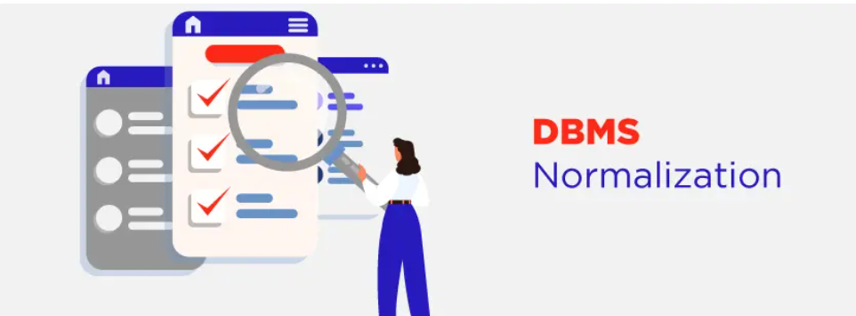

Slide 2
Triggers in PL/SQL
Triggers in oracle are blocks of PL/SQL code which oracle engine can execute automatically based on some action or event.
These events can be:
  DDL statements (CREATE, ALTER, DROP, TRUNCATE)
  DML statements (INSERT, SELECT, UPDATE, DELETE)
  Database operation like connecting or disconnecting to oracle (LOGON, LOGOFF, SHUTDOWN)

Slide 3
Triggers….
Triggers are automatically and repeatedly called upon by oracle engine on satisfying certain condition.
Triggers can be activated or deactivated depending on the requirements.
If triggers are activated then they are executed implicitly by oracle engine and if triggers are deactivated then they are executed explicitly by oracle engine.

Slide 4
PL/SQL: Uses of Triggers
Here we have mentioned a few use cases where using triggers proves very helpful:
Maintaining complex constraints which is either impossible or very difficult via normal constraint(like primary, foreign, unique etc) applying technique.
Recording the changes made on the table.
Automatically generating primary key values.
Prevent invalid transactions to occur.
Granting authorization and providing security to database.
Enforcing referential integrity.

Slide 5
PL/SQL: Parts of a Trigger
Whenever a trigger is created, it contains the following three sequential parts:
Triggering Event or Statement: The statements due to which a trigger occurs is called triggering event or statement. Such statements can be DDL statements, DML statements or any database operation, executing which gives rise to a trigger.

Slide 6
PL/SQL: Parts of a Trigger
Trigger Restriction: The condition or any limitation applied on the trigger is called trigger restriction. Thus, if such a condition is TRUE then trigger occurs otherwise it does not occur.
Trigger Action: The body containing the executable statements that is to be executed when trigger occurs that is with the execution of Triggering statement and upon evaluation of Trigger restriction as True is called Trigger Action.

Slide 7
PL/SQL: Types of Triggers
The above diagram clearly indicated that Triggers can be classified into three categories:
  Level Triggers
  Event Triggers
  Timing Triggers
which are further divided into different parts.

Slide 8
Level Triggers
There are 2 different types of level triggers, they are:
ROW LEVEL TRIGGERS
  It fires for every record that got affected with the execution of DML statements like INSERT, UPDATE, DELETE etc.
  It always use a FOR EACH ROW clause in a triggering statement.
STATEMENT LEVEL TRIGGERS
  It fires once for each statement that is executed.

Slide 9
Event Triggers
There are 3 different types of event triggers, they are:
DDL EVENT TRIGGER
  It fires with the execution of every DDL statement(CREATE, ALTER, DROP, TRUNCATE).
DML EVENT TRIGGER
  It fires with the execution of every DML statement(INSERT, UPDATE, DELETE).
DATABASE EVENT TRIGGER
  It fires with the execution of every database operation which can be LOGON, LOGOFF, SHUTDOWN, SERVERERROR etc.

Slide 10
Timing Triggers
There are 2 different types of timing triggers, they are:
BEFORE TRIGGER
  It fires before executing DML statement.
  Triggering statement may or may not executed depending upon the before condition block.
AFTER TRIGGER
  It fires after executing DML statement.

Slide 11
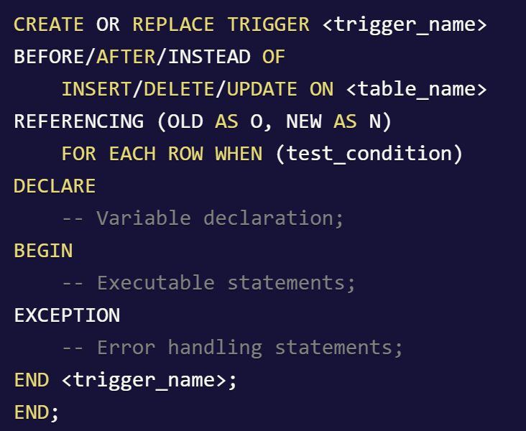
Syntax for creating Triggers

Slide 12
Trigger example
CREATE OR REPLACE TRIGGER CheckAge
BEFORE
INSERT OR UPDATE ON student
FOR EACH ROW
BEGIN
IF :new.Age>30 THEN
raise_application_error(-20001, 'Age should not be greater than 30');
END IF;
END;

Slide 13
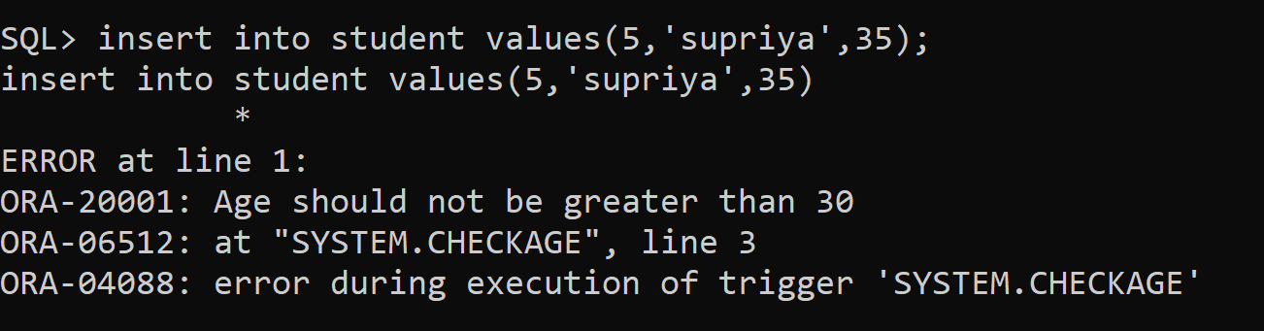
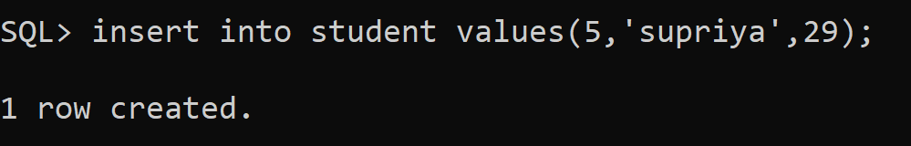
Output of the trigger;

Slide 14


